Slide 1

MALLA REDDY COLLEGE OF ENGINEERING & TECHNOLOGY
Department of Aeronautical Engineering
MAJOR PROJECT
Design and Analysis of Hybrid VTOL Wing using Simple AI Algorithm
Under the Guidance of Presented by: Batch No: 2
Mr. M. Yugender SHAIK NAWAZ (20N31A2134)
Associate Professor TIRUMALA SAI NITHIN (20N31A2135)
V.HIMABINDU (20N31A2136)

Slide 2
ABSTRACT
This project focuses on the conceptualization, design, and analysis of a novel Hybrid Vertical Takeoff and Landing (VTOL) wing for a Radio-Controlled (RC) plane. The objective is to enhance the aircraft's versatility by integrating both fixed-wing and VTOL capabilities, allowing it to take off and land vertically while maintaining efficient forward flight. The research encompasses aerodynamic considerations, structural design, and control system integration to achieve optimal performance in various flight modes. Through a combination of theoretical modeling, computational simulations, and practical experimentation, the project aims to demonstrate the feasibility and efficiency of the proposed hybrid VTOL wing for RC planes. The outcomes of this study could contribute to advancements in the field of unmanned aerial vehicles, expanding the capabilities of RC aircraft for diverse applications.

Slide 3
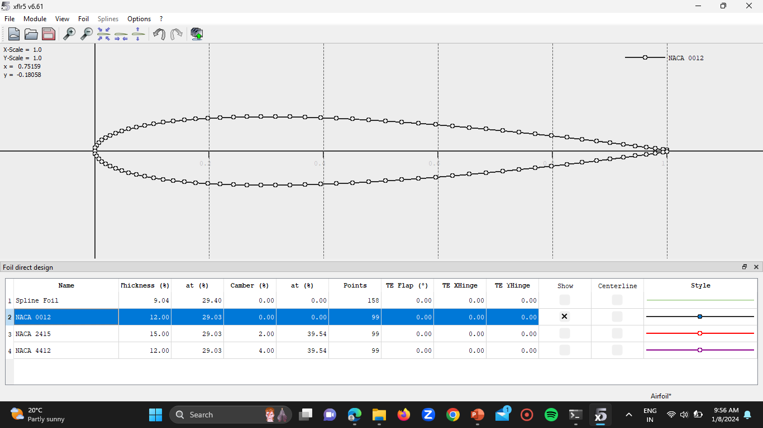
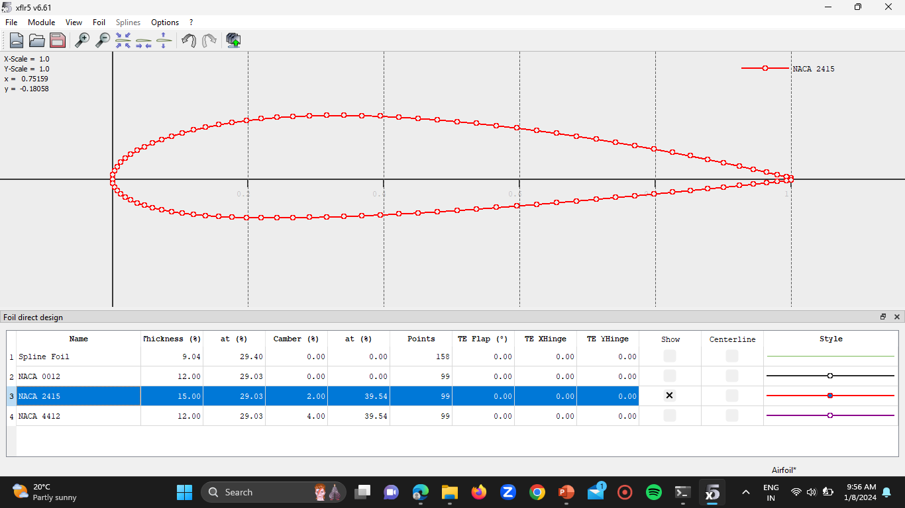
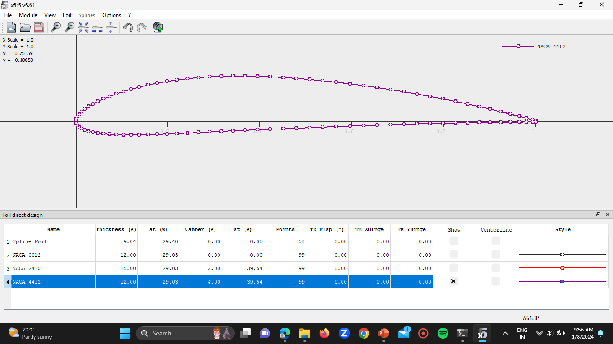
AIRFOIL COMBINATION
N
A
C
A
0
0
1
2
N
A
C
A
2
4
1
5
WHY?
The selection of air foil combinations such as NACA 0012, NACA 4412, and NACA 2415 for a hybrid VTOL (Vertical Take-off and Landing) RC (Remote Control) plane wing offers several advantages, primarily in terms of aerodynamic performance, stability, and control.
1. Aerodynamic Efficiency
2. Versatility
3. Stability and Control
4. Structural Considerations
5. Efficiency in VTOL Operations
In summary, the selection of air foil combinations such as NACA 0012, NACA 4412, and NACA 2415 for a hybrid VTOL RC plane wing offers a balanced approach to aerodynamic performance, stability, and control, enabling efficient operation across a wide range of flight conditions, from vertical take-off and landing to forward flight.
N
A
C
A
4
4
1
2

Slide 4
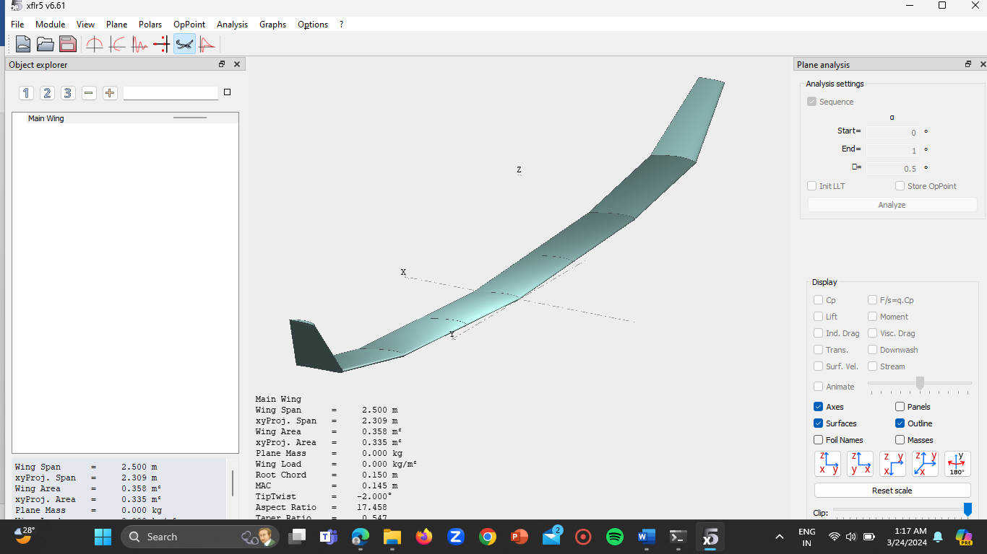
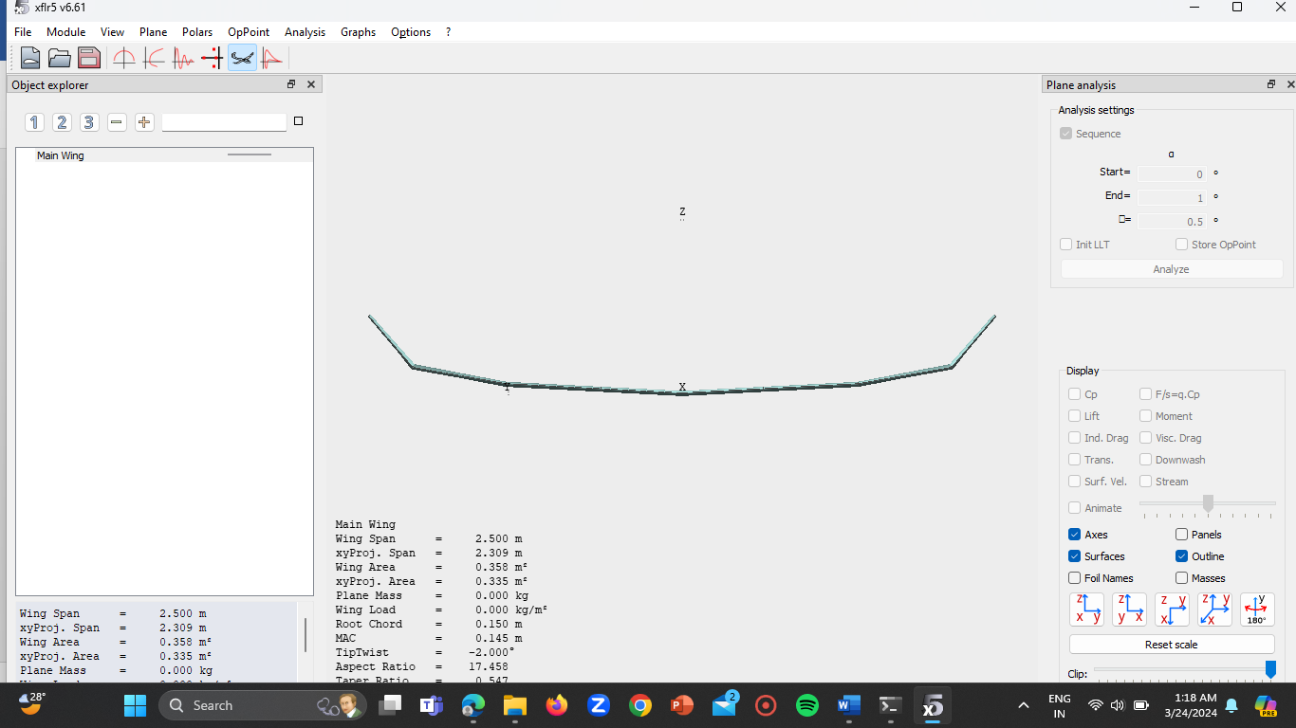
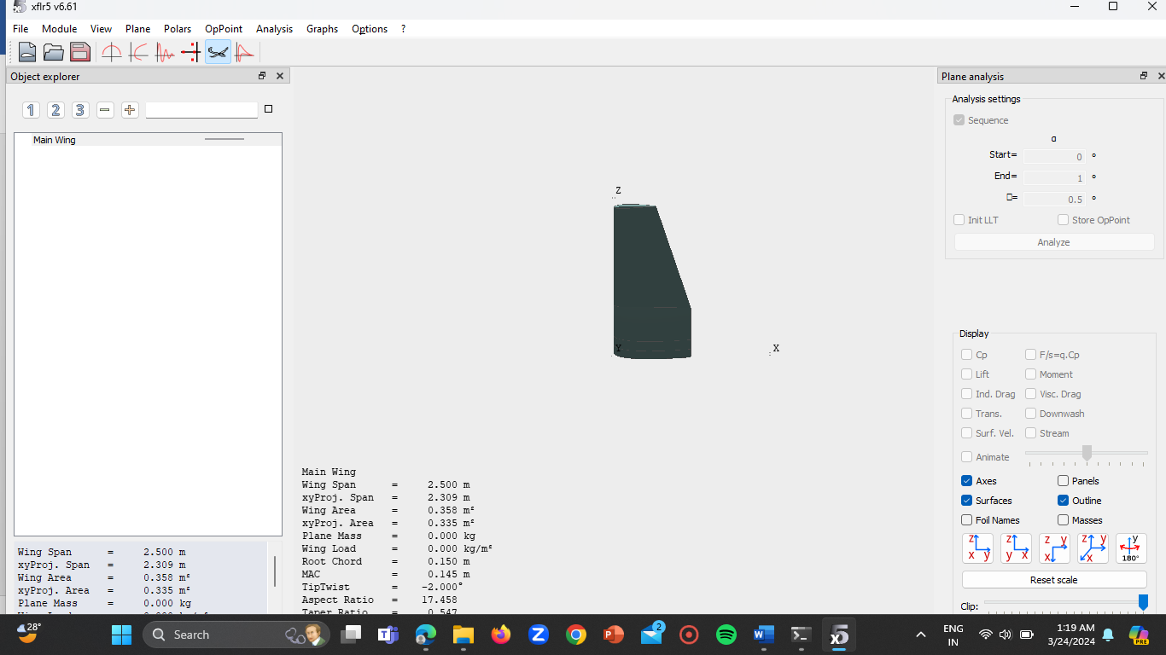
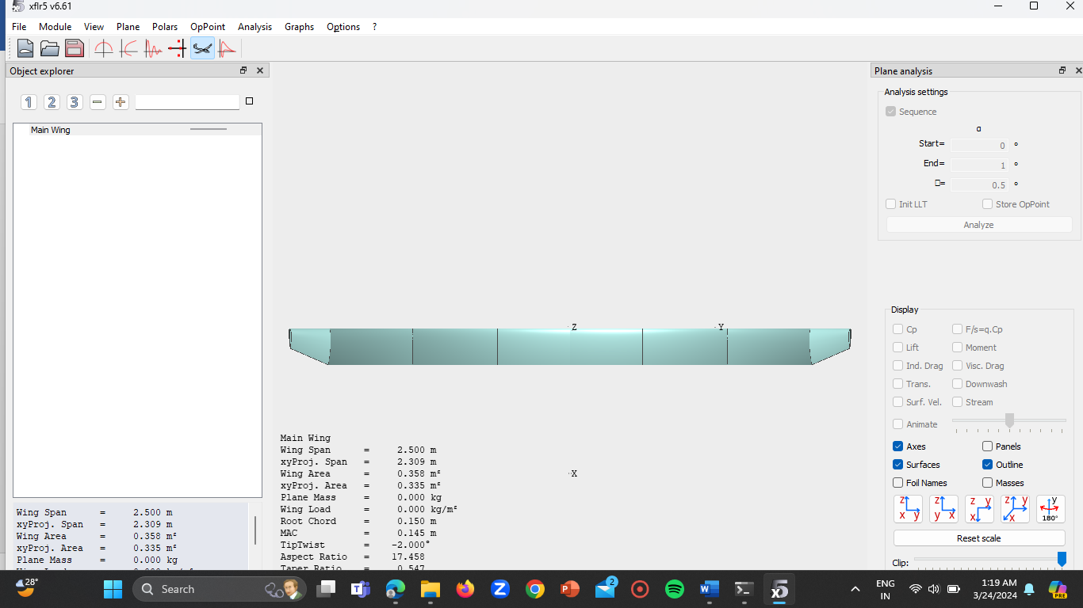
WING DESIGN (Optimised) – XFLR5

Slide 5
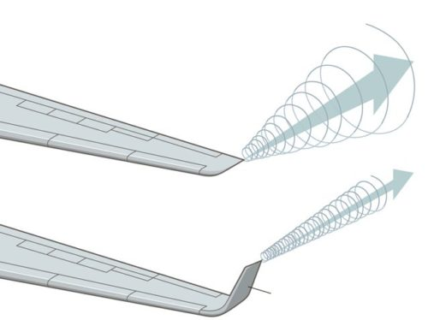
WHY WINGLETS?
Winglets, when incorporated into the design of a hybrid Vertical Takeoff and Landing (VTOL) Remote-Controlled (RC) plane, offer several advantageous features.
1. Reduced Induced Drag
2. Enhanced Stability
3. Improved Fuel Efficiency
4. Reduced Wingtip Vortices
5. Enhanced Performance in Crosswinds
6. Aesthetic and Branding Considerations
In summary, incorporating winglets into the design of a hybrid VTOL RC plane offers numerous advantages including reduced induced drag, enhanced stability, improved fuel efficiency, reduced wingtip vortices, enhanced performance in crosswinds, and potential aesthetic and branding benefits. These features collectively contribute to optimizing the performance, safety, and operational capabilities of the aircraft.

Slide 6
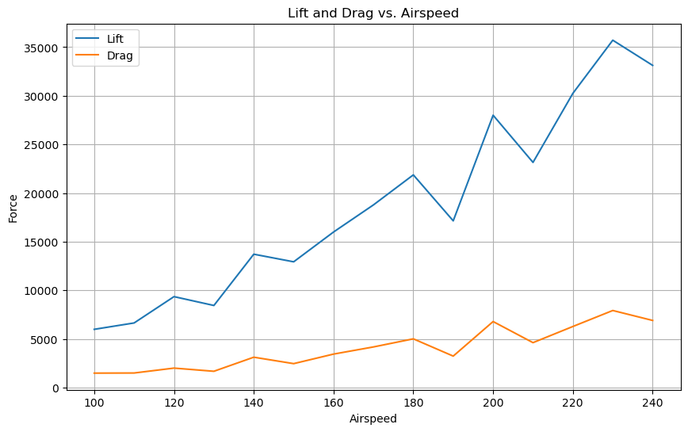
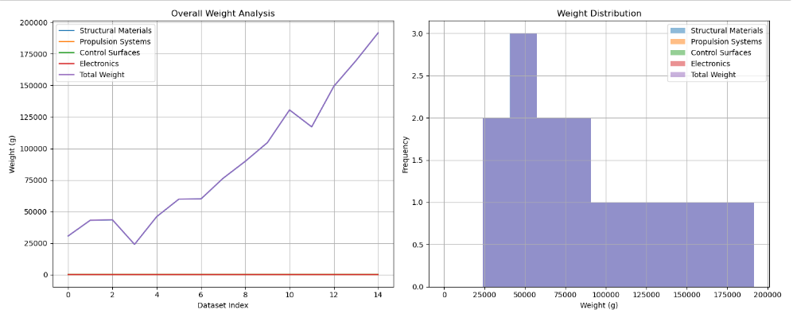
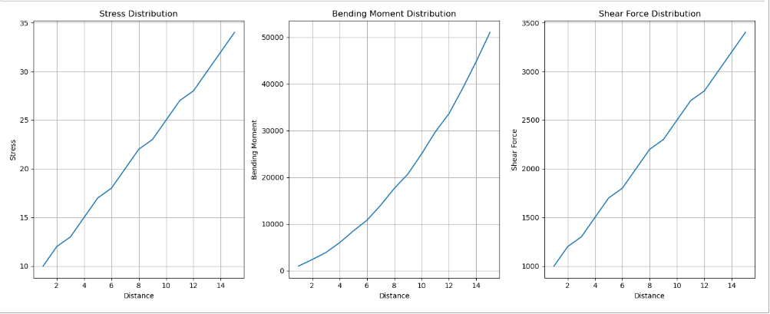
AI ANALYSIS MODEL RESULTS
1. Lift and Drag Calculation
2. Structural Analysis
3. Weight Estimation

Slide 7
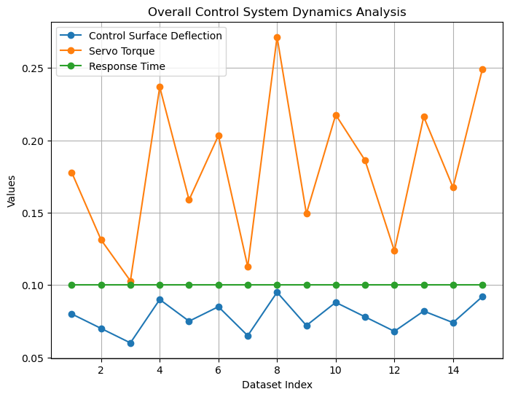
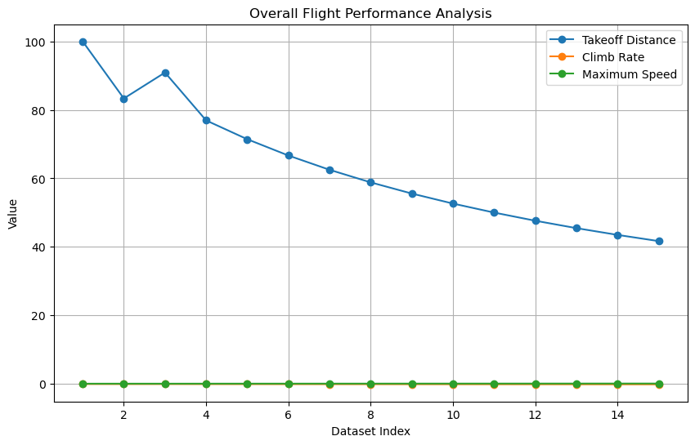
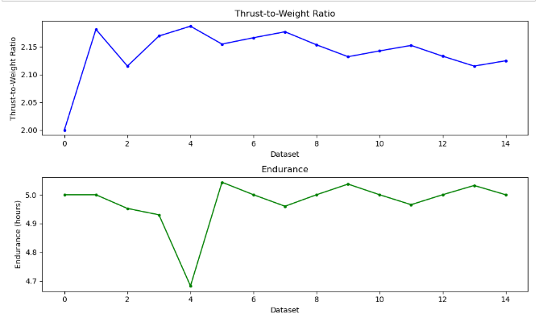
AI ANALYSIS MODEL RESULTS
1. Power system Sizing
2. Control System Dynamics
3. Flight Performance prediction

Slide 8
AI CODE
import pandas as pd
import matplotlib.pyplot as plt
# Load data from CSV file
data = pd.read_csv("Structural_Analysis_data.csv")
# Define functions for analysis
def calculate_stresses(load, moment_of_inertia, distance_from_neutral_axis):
stress = load / moment_of_inertia * distance_from_neutral_axis
return stress
def calculate_bending_moments(load, distance):
bending_moment = load * distance
return bending_moment
def calculate_shear_forces(load):
shear_force = load
return shear_force
# Calculate stresses, bending moments, and shear forces using data from CSV
data['Stress'] = calculate_stresses(data['Load'], data['Moment_of_Inertia'], data['Distance_from_Neutral_Axis'])
data['Bending_Moment'] = calculate_bending_moments(data['Load'], data['Distance'])
data['Shear_Force'] = calculate_shear_forces(data['Load'])
# Plot stress, bending moment, and shear force
plt.figure(figsize=(15, 6))
plt.subplot(1, 3, 1)
plt.plot(data['Distance'], data['Stress'], label='Stress')
plt.xlabel('Distance')
plt.ylabel('Stress')
plt.title('Stress Distribution')
plt.grid(True)
plt.subplot(1, 3, 2)
plt.plot(data['Distance'], data['Bending_Moment'], label='Bending Moment')
plt.xlabel('Distance')
plt.ylabel('Bending Moment')
plt.title('Bending Moment Distribution')
plt.grid(True)
plt.subplot(1, 3, 3)
plt.plot(data['Distance'], data['Shear_Force'], label='Shear Force')
plt.xlabel('Distance')
plt.ylabel('Shear Force')
plt.title('Shear Force Distribution')
plt.grid(True)
plt.tight_layout()
plt.show()
import pandas as pd
import matplotlib.pyplot as plt
import numpy as np
# Load data from CSV file
data = pd.read_csv("Lift_Drag_data.csv")
# 1. Lift and Drag calculation
def calculate_lift_drag(airspeed, angle_of_attack, lift_coefficient, drag_coefficient):
lift = 0.5 * lift_coefficient * airspeed**2
drag = 0.5 * drag_coefficient * airspeed**2
return lift, drag
lift, drag = calculate_lift_drag(data['Airspeed'], data['Angle_of_Attack'], data['Lift_Coefficient'], data['Drag_Coefficient'])
# Plot Lift and Drag
plt.figure(figsize=(10, 6))
plt.plot(data['Airspeed'], lift, label='Lift')
plt.plot(data['Airspeed'], drag, label='Drag')
plt.xlabel('Airspeed')
plt.ylabel('Force')
plt.title('Lift and Drag vs. Airspeed')
plt.legend()
plt.grid(True)
plt.show()

Slide 9
AI CODE
import pandas as pd
import matplotlib.pyplot as plt
# Load data from CSV file
data = pd.read_csv("Weight_Analysis_data.csv")
# Define functions for weight estimation
def estimate_weight_structural_materials(wing_area, wing_loading, material_density):
weight_structural_materials = wing_area * wing_loading / 9.81 * material_density
return weight_structural_materials
def estimate_weight_propulsion_systems(propulsion_power):
weight_propulsion_systems = 0.1 * propulsion_power
return weight_propulsion_systems
def estimate_weight_control_surfaces(control_surface_area, control_surface_density):
weight_control_surfaces = control_surface_area * control_surface_density
return weight_control_surfaces
def estimate_weight_electronics(electronics_weight):
weight_electronics = electronics_weight
return weight_electronics
# Iterate over each row in the DataFrame
for index, row in data.iterrows():
# Extract data from the current row
wing_area = row['Wing_Area']
wing_loading = row['Wing_Loading']
material_density = row['Material_Density']
propulsion_power = row['Propulsion_Power']
control_surface_area = row['Control_Surface_Area']
control_surface_density = row['Control_Surface_Density']
electronics_weight = row['Electronics_Weight']
# Estimate weights
weight_structural_materials = estimate_weight_structural_materials(wing_area, wing_loading, material_density)
weight_propulsion_systems = estimate_weight_propulsion_systems(propulsion_power)
weight_control_surfaces = estimate_weight_control_surfaces(control_surface_area, control_surface_density)
weight_electronics = estimate_weight_electronics(electronics_weight)
# Total weight estimation
total_weight = (weight_structural_materials +
weight_propulsion_systems +
weight_control_surfaces +
weight_electronics)
# Print the estimated weights for the current dataset
print(f"Dataset {index + 1}:")
print("Estimated Weight of Structural Materials:", weight_structural_materials, "g")
print("Estimated Weight of Propulsion Systems:", weight_propulsion_systems, "g")
print("Estimated Weight of Control Surfaces:", weight_control_surfaces, "g")
print("Estimated Weight of Electronics:", weight_electronics, "g")
print("Total Estimated Weight of Wing:", total_weight, "g")
# Plotting
plt.figure(figsize=(15, 6))
plt.subplot(1, 2, 1)
plt.bar(['Structural Materials', 'Propulsion Systems', 'Control Surfaces', 'Electronics'],
[weight_structural_materials, weight_propulsion_systems, weight_control_surfaces, weight_electronics])
plt.xlabel('Component')
plt.ylabel('Weight (g)')
plt.title('Weight Distribution')
plt.grid(True)
plt.subplot(1, 2, 2)
plt.pie([weight_structural_materials, weight_propulsion_systems, weight_control_surfaces, weight_electronics],
labels=['Structural Materials', 'Propulsion Systems', 'Control Surfaces', 'Electronics'], autopct='%1.1f%%')
plt.title('Weight Distribution')
plt.axis('equal')
plt.tight_layout()
plt.show()

Slide 10
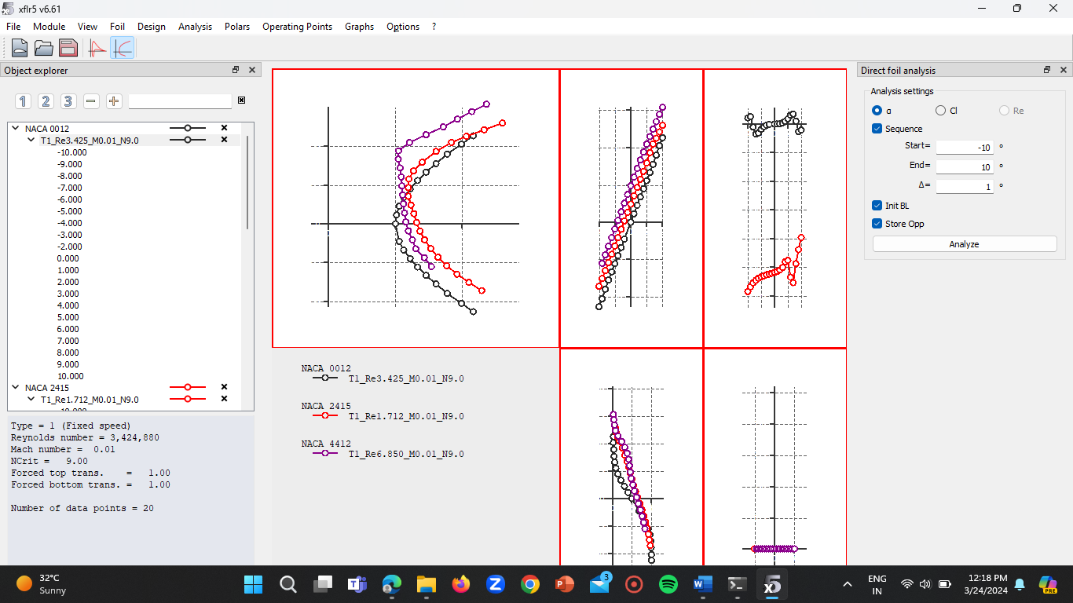
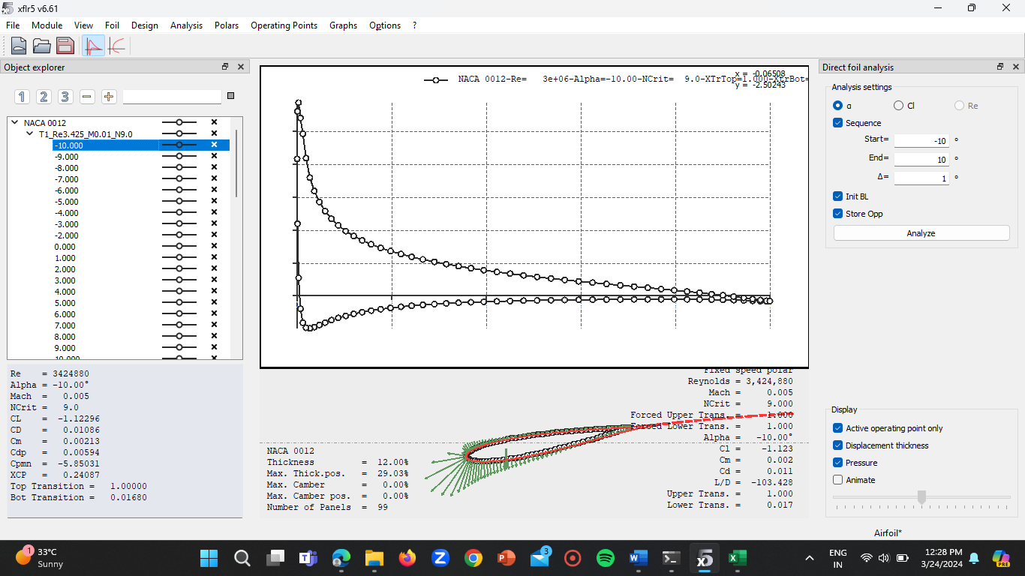
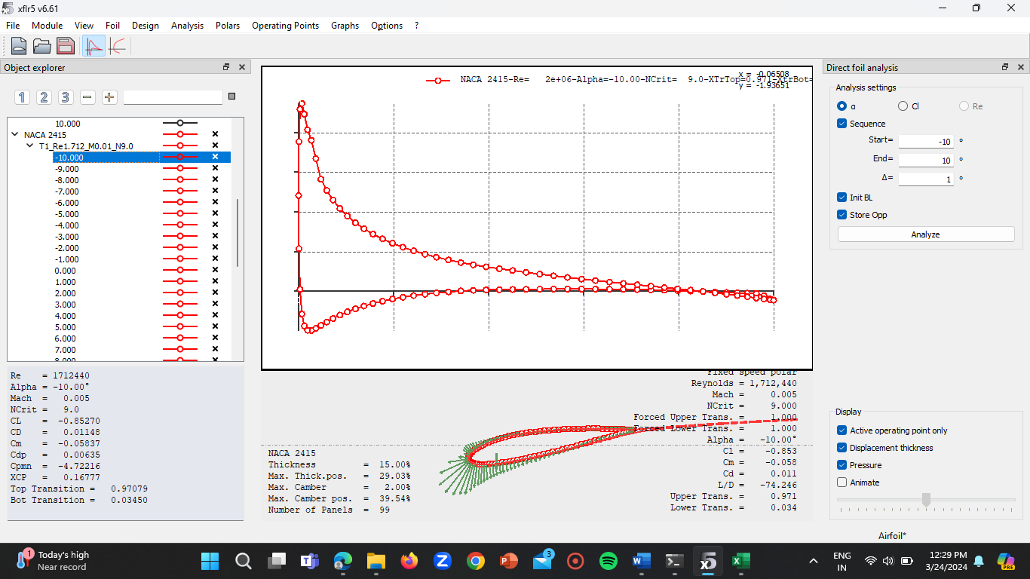
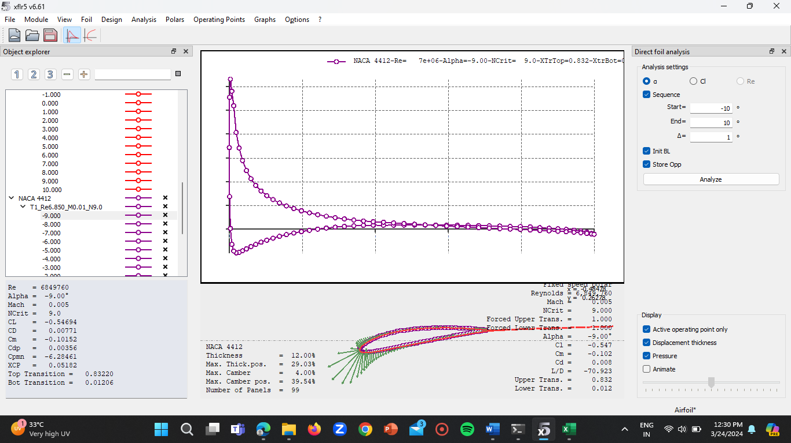
AIRFOIL ANALYSIS – XFLR5

Slide 11
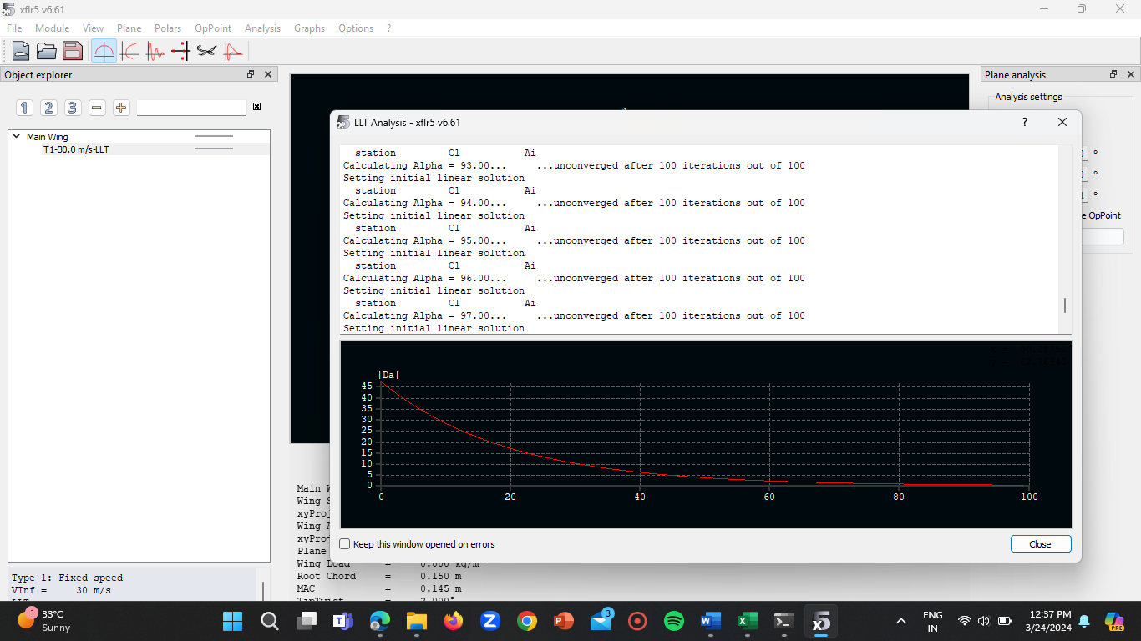
WING ANALYSIS – XFLR5

Slide 12
MANUAL CALCULATIONS
Wing Loading(WL):
WL = (W)/(S)
Where;
W = Weight of the Aircraft (kg)
S = Wing Area (m^2)
WL = 9/0.38
WL= 23.68 kg/m^2
Stall Speed (Vs):
Vs = sqrt [(2 x W)/ (density x S x CLmax)]
Where;
W = Weight of the plane
S = Wing Area
CLmax = Maximum Lift Coefficient [i.e, (1.5)]
Vs = sqrt [(2 x 9)/ (1.225 x 0.38 x 1.5)]
Vs = sqrt [(18)/ (0.86775)]
Vs = sqrt [20.747]Vs = 4.55 m/sec
Aspects Ratio(AR):
AR = b²/S
Where:
b = wing span
S = wing area
AR = (2.246)²/0.38
AR = 13.27

Slide 13

THANK YOU

